Slide 1

MODY UNIVERSITY OF SCIENCE AND TECHNOLOGY
SCHOOL OF ENGINEERING AND TECHNOLOGY
PROGRAMMING LANGUAGE(CS-16.103)
PROJECT BASED LEARNING-PHASE I
SUBMITTED TO - DR.ANAND SHARMA
SUBMITTED BY-
NIDHI CHOUDHARY
YUKTI GOYAL
HIRAL JAIN
AKSHITA KANTHER
SIMRAN JAIN

Slide 2
CONTENT
Introduction
WHY C?
FEATURES
ALGORITHM
SPECIFICATIONS
BIBLIOGRAPHY

Slide 3
INTRODUCTION
C is a programming language that was developed by AT&T’s BELL LABORATORIES of USA in 1972.It was written and designed by DENNIS RITCHIE . It replaced languages like ALGOL because of the close analogy between learning English language and learning C language.

Slide 4
Why C ?
We use C due to it’s salient features.
And why C seems to be popular is because it is reliable, simple and easy to use. Moreover , when it comes to performance (speed of execution) nothing beats C.If one is to extend the operating system to work with new devices one needs to write device driver program which are exclusively written in C.

Slide 5
PORTABLE
MID-LEVEL
STRUCTURED
USER-FRIENDLY
C-Language
FASTER
EXTENSIBLE
POINTERS
RECURSION

Slide 6
Why quiz?
In computer system ,it is not necessary to create the manifest but we can directly print it which saves out time.
Easy to understand by the user.
Easy to operate.
Manage the information of questions.
Leads to error free , secure ,reliable and fast management system.

Slide 7
This quiz includes various genres like Bollywood ,geography , g. k.. etc. on the basis of user’s choice a number of questions are asked and the user is awarded one point for each correct answer . There will be no negative marking .at the end of the quiz the total score of the user will be displayed.

Slide 8
SELECTION STATEMENTS
2.1 if statement
A statement or set of statements are executed when the condition is true,otherwise these are skipped.
SYNTAX:
if(condition)
{
Statement(s);
}
2.2 if-else statement
This statement executes one of two alternative statements,according to specified condition.
SYNTAX:
if(condition)
{
Statement(s);
}
else
{
Statement(s);
}

Slide 9
2.3 if-else-if statement
This statement executes more than two alternative conditional statements according to the specified conditions.
SYNTAX:
if(condition 1)
{ statement(s);}
else if(condition 2)
{ statement(s);}
else if(condition 3)
{ statement(s);}
:
:
else
{ statement(s);}

Slide 10
2.4 NESTED IF STATEMENT
An if statement can be used within another if or else statement .This is called nested if statement.
SYNTAX:
if(condition 1)
{
Statement 1;
if(condition 2)
statement 2;
}
else
if(condition 3)
statement 3;

Slide 11
2.5 SWITCH STATEMENT
This statement provides an alternative to if-else-if construct.It is a multiway branching statement.The switch statement uses one or more case labels.If no matches found ,the default block will be executed.
SYNTAX:
switch(expression)
{
case 1:
block 1;
break;
case 2:
:
:
default: statement;
}

Slide 12
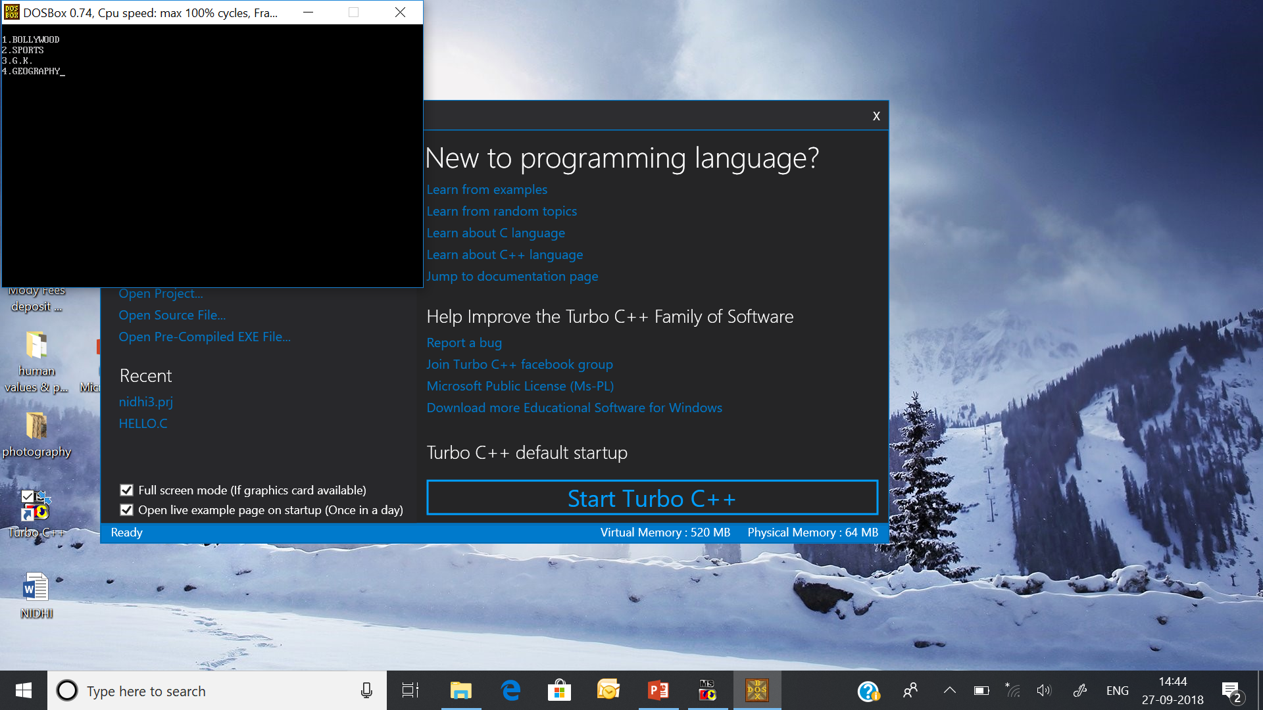
algorithm
Declaration of variable ‘N’ , ’a’, ‘c=0’.
MENU REGARDING THE VARIOUS GENRES IS DISPLAYED.
USER’S CHOICE IS STORED IN VARIABLE ‘N’.
USING THE SWITCH STATEMENT AND VARIABLE ‘N’ AS THE INTEGER EXPRESSION ,THE VALUE OF ‘N’ IS MATCHED AGAINST THE CONSTANT VALUES THAT FOLLOW THE CASE STATEMENT.

Slide 13
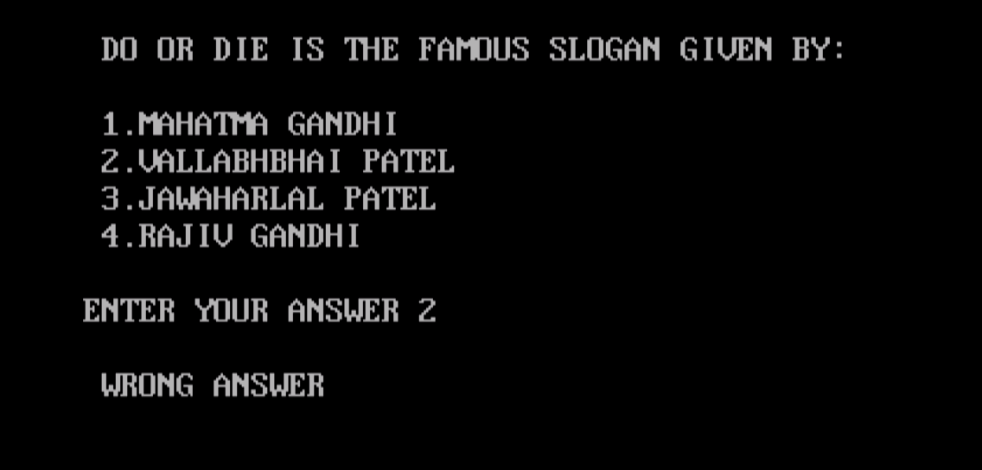
WHEN MATCH IS FOUND ,THE PROGRAM EXECUTES THE STATEMENTS FOLLOWING THAT CASE – questions corresponding to the genre will be displayed. if the match is not found then default will be executed displaying inappropriate choice.
The answer of the user will be stored in variable ‘a’.
Using the if statement answer will be matched if it is a right answer then value of ‘c’ will be incremented.
At the end value of ‘c’ will be printed displaying the number of correct answers.

Slide 14
bibliography
Let us c –yashavant kanetkar
Programming in ansi c – e balagurusamy
The complete reference c – Herbert schildt

